Slide 1
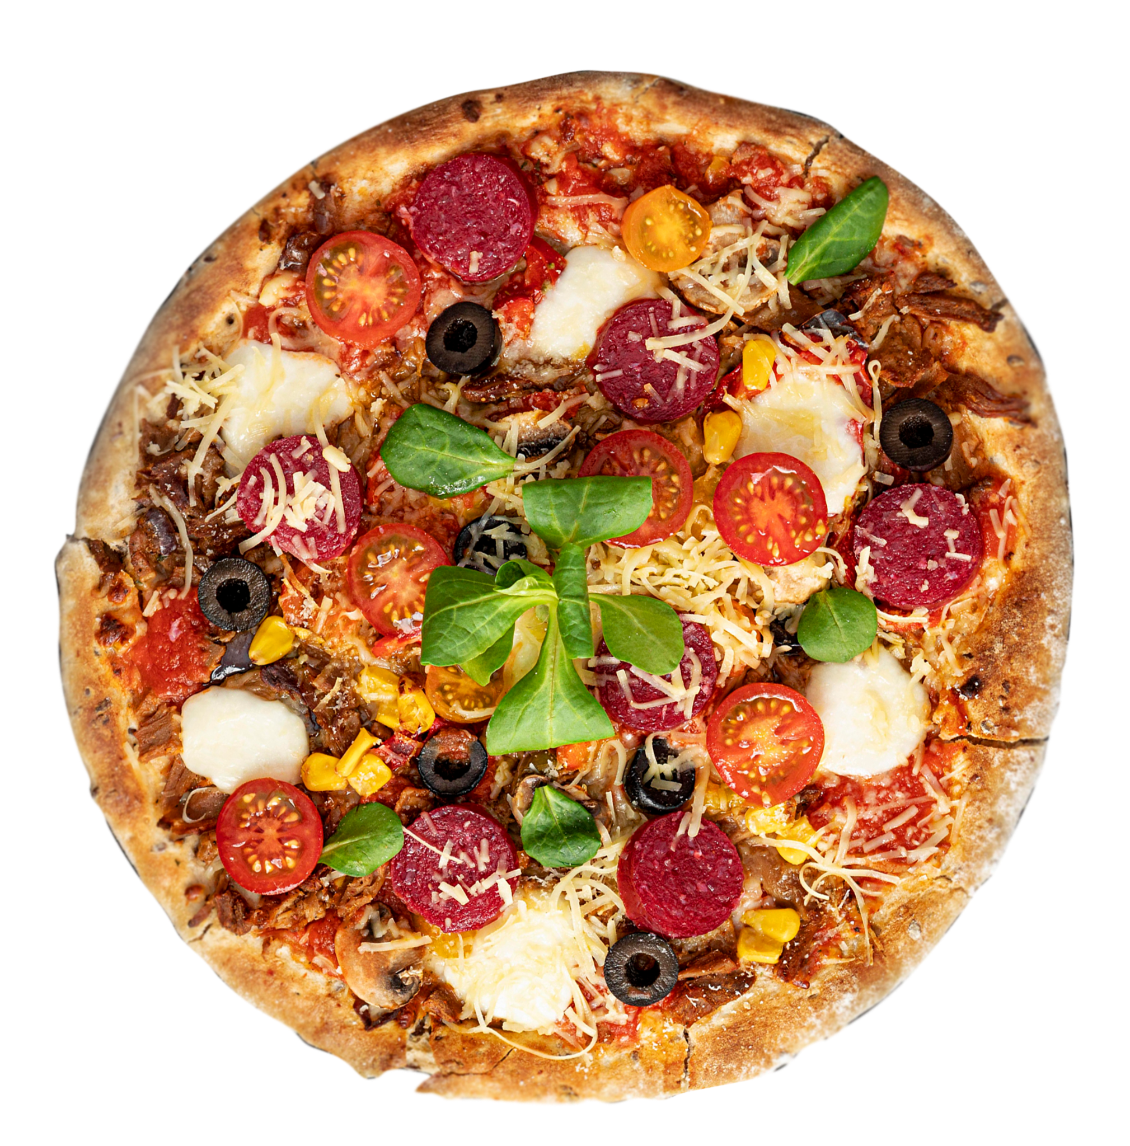



FOOD DONATION PLATFORM
Group 15 | 2023
CEF440 - Internet Programming and Mobile Programming

Slide 2
TABLE OF CONTENTS
SOFTWARE REQUIREMENTS
01
INTRODUCTION
03
02
SURVEY
04
CONCLUSION

Slide 3




01
INTRODUCTION
GROUP 15 | 2023
Brief summary of the purpose, scope and objective of the platform

Slide 4



INTRODUCTION
The platform aims to reduce food waste and promote food donation by allowing individuals and businesses to upload their excess food offerings to the platform.
Purpose
Scope
Goals and Objectives
Overview

Slide 5
02
SURVEY
GROUP 15 | 2023
Brief summary of results obtained

Slide 6

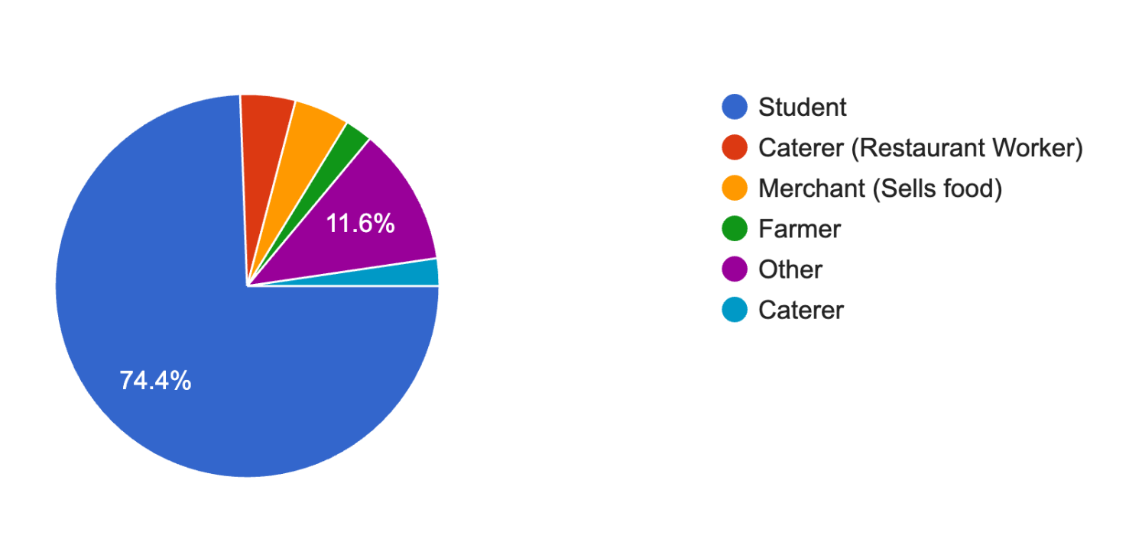
Stakeholders
GROUP 15 | 2023

Slide 7
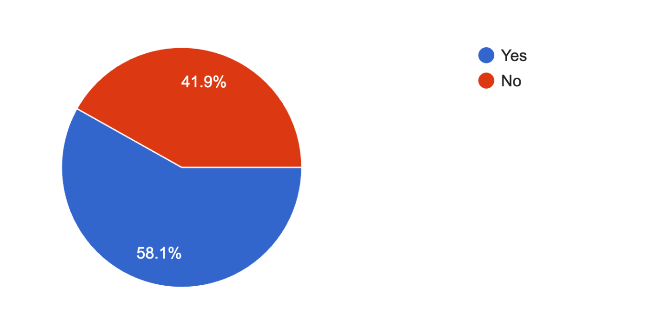
Have you had excess food in your possession?
GROUP 15 | 2023

Slide 8
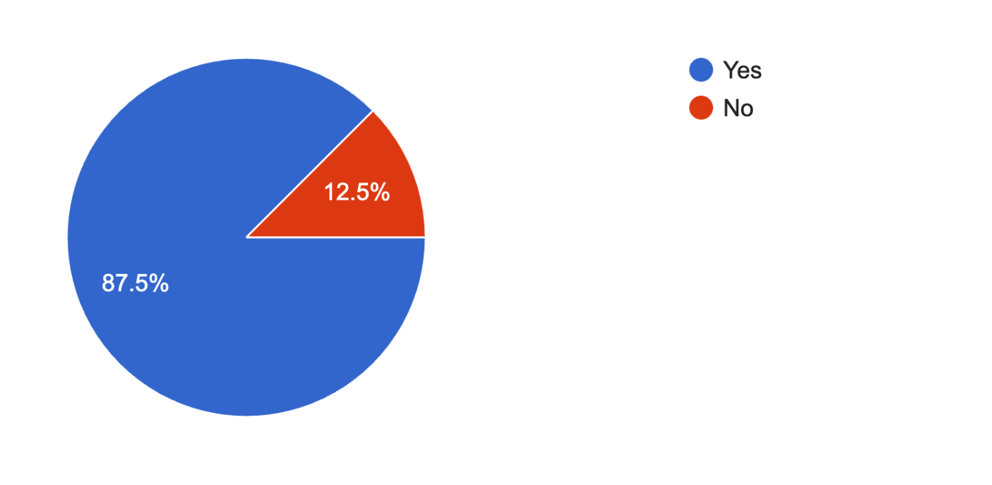
Would you willing to give it out for free or at a discounted price?
GROUP 15 | 2023

Slide 9
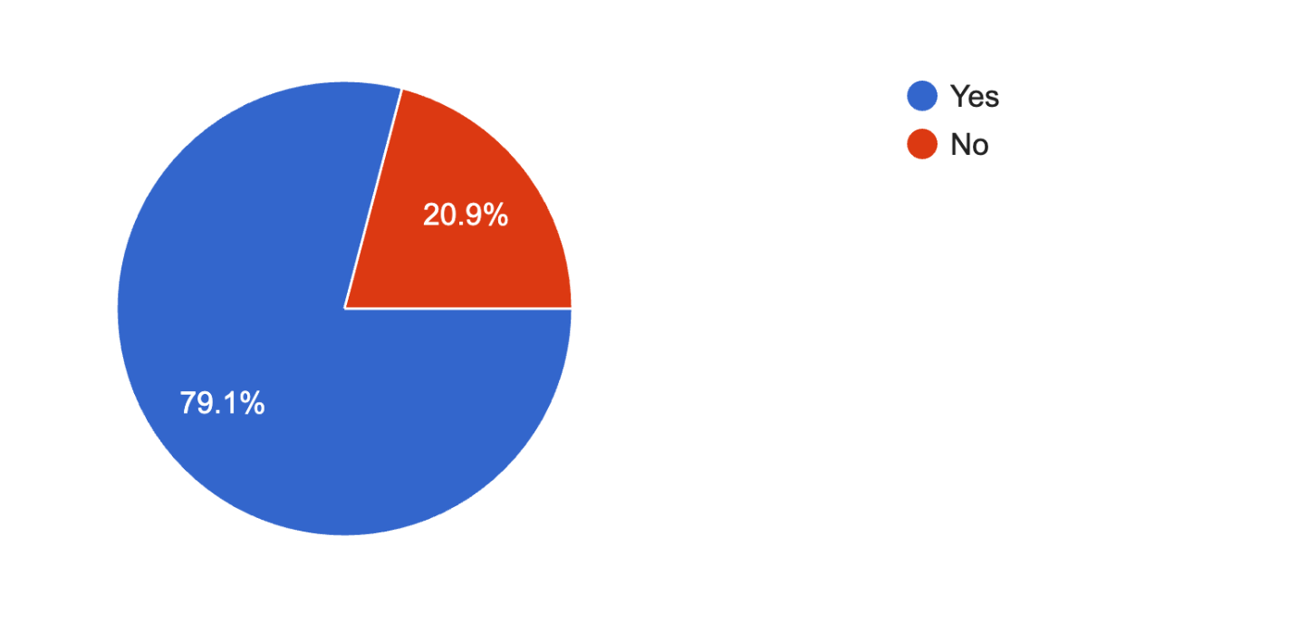
Would you be willing to take food from someone for free or at a discounted price?
GROUP 15 | 2023

Slide 10
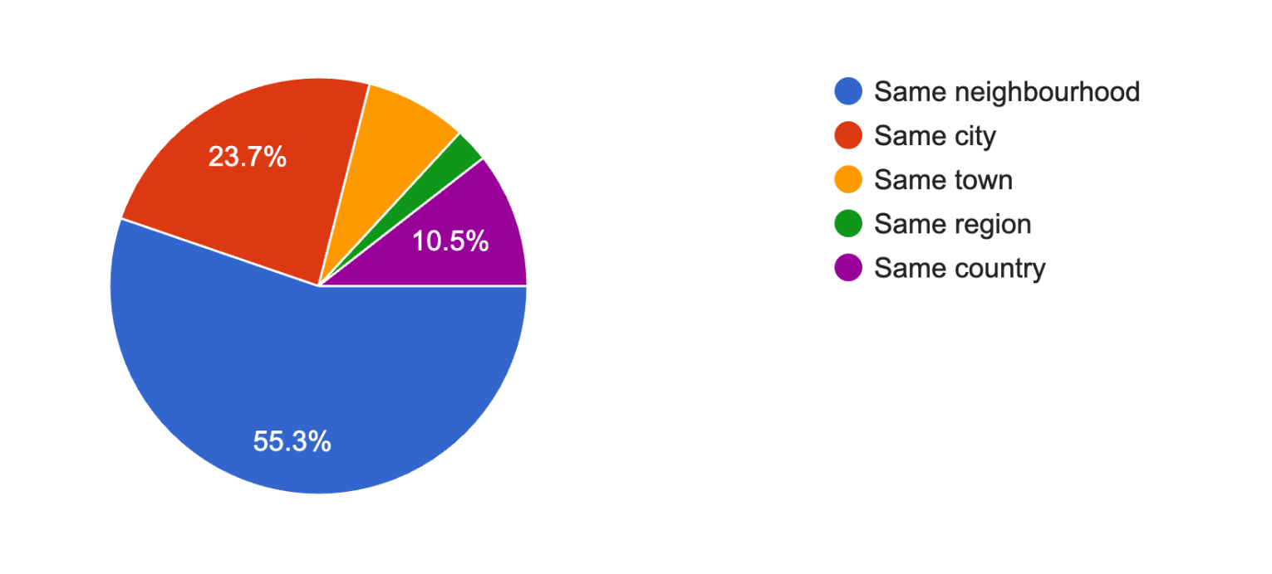
How far should the person be?
GROUP 15 | 2023

Slide 11
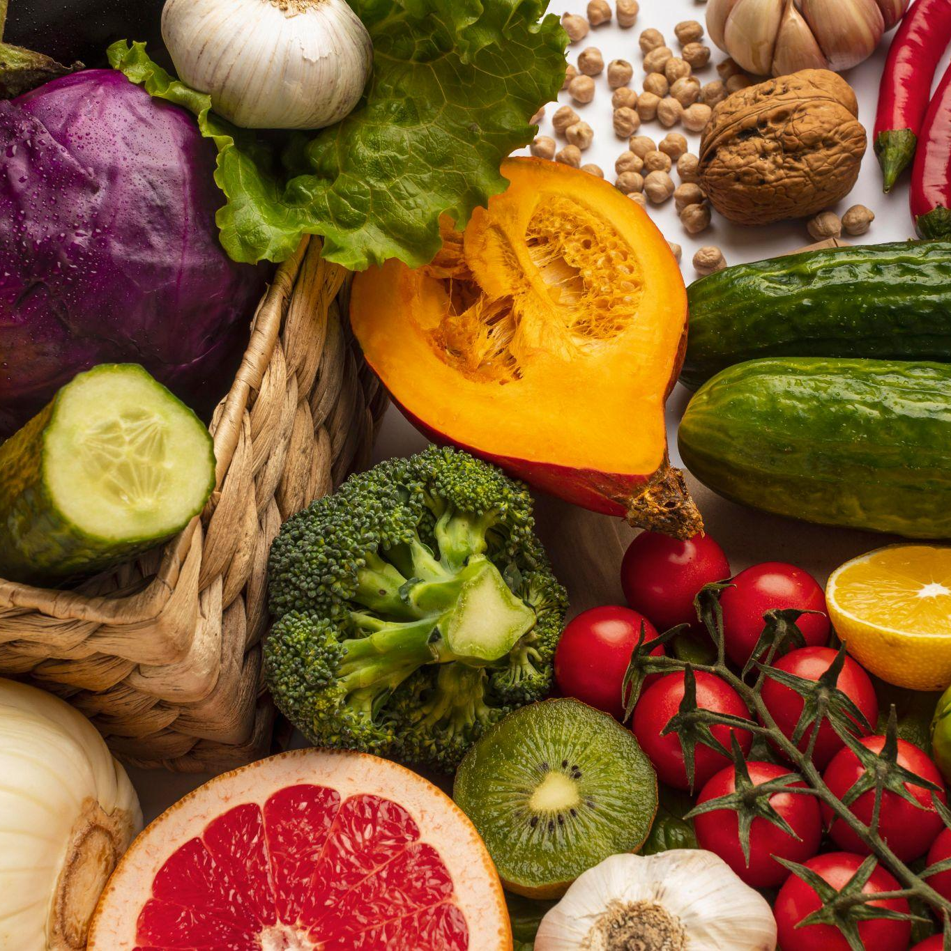
Analysis of Survey
Most participants have excess food in their possession
Almost all participants are willing to give excess food out for free or at a discounted price
78% of the participants are willing to take food from a donor for free or at a discounted price
Most of the participants will be willing to take food if it is from a person in thesame city as them

Slide 12
03
SOFTWARE REQUIREMENTS
GROUP 15 | 2023
Brief summary of functional and non-functional requirements

Slide 13
FUNCTIONAL REQUIREMENTS
User registration
Donor upload
Search and browse
Payment
Messaging
Notification system

Slide 14
Non-Functional Requirements
Performance
Accessibility
Scalability
Usability

Slide 15

CONCLUSION
GROUP 15 | 2023

Slide 16

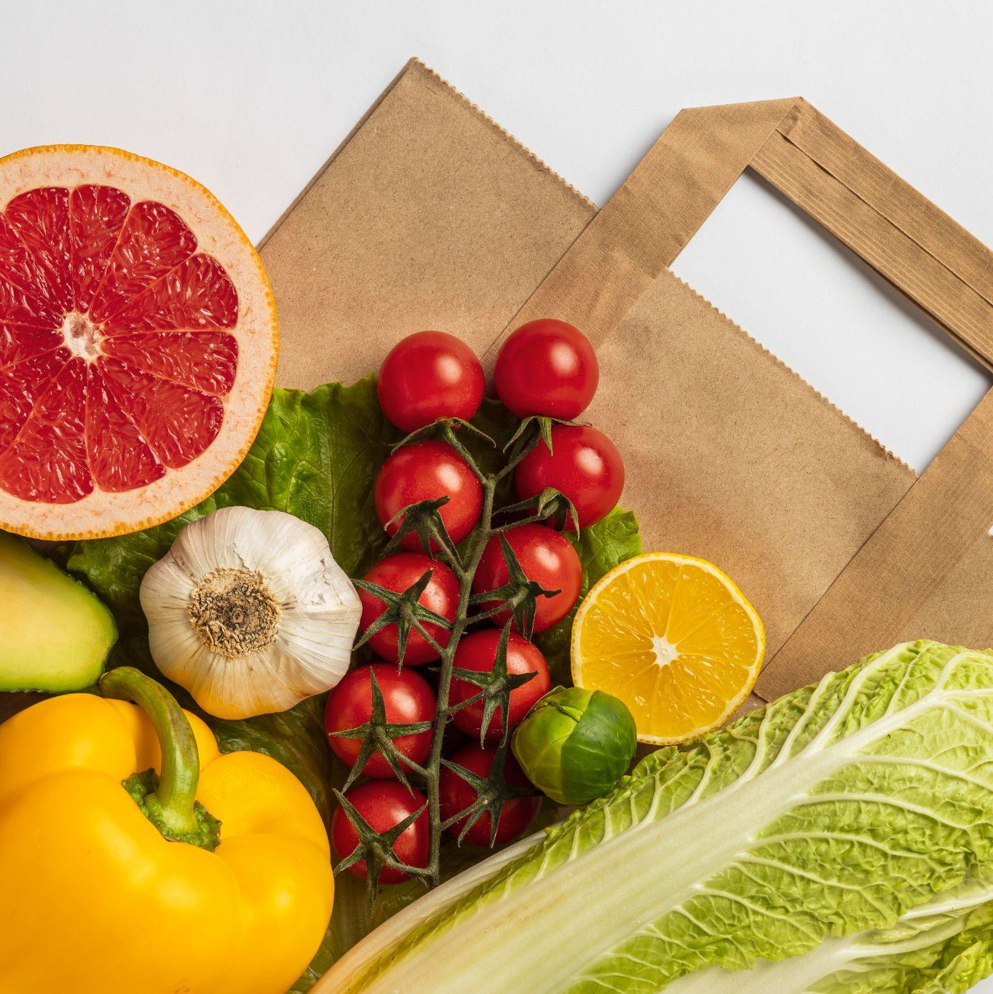
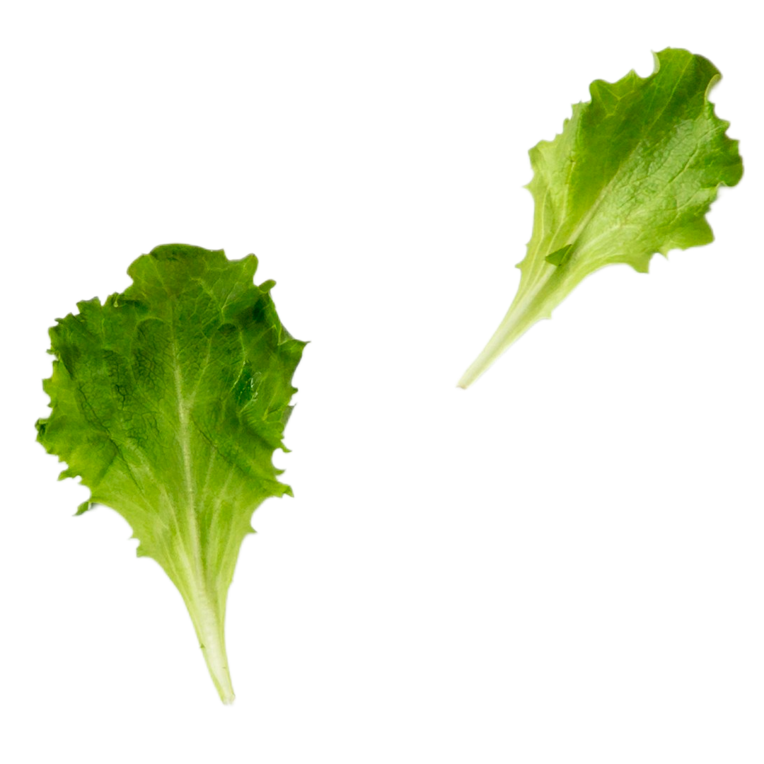
THANKS!
GROUP 15 | 2023
Do you have any questions?
Group 15

